Slide 1
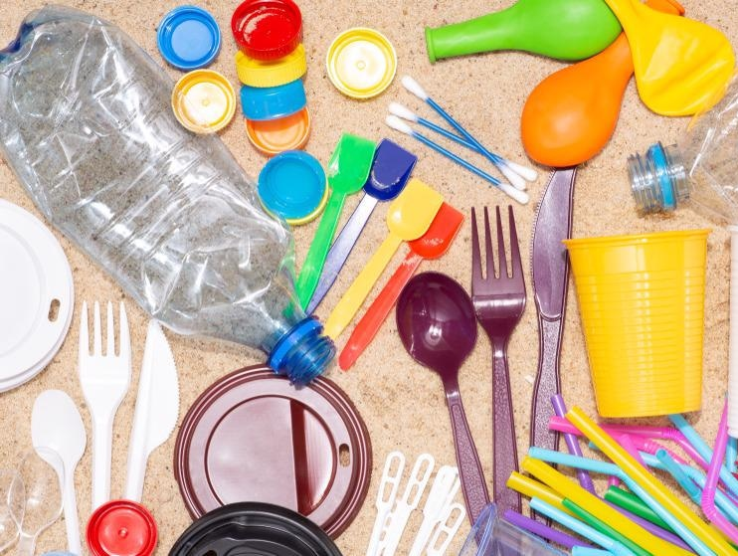
higher Design & Manufacture
Plastic Theory

Slide 2
Learning intentions & success criteria
Learning Intentions
To develop an understanding of the properties and uses of plastic in everyday objects.
Success Criteria
I can name 5 commonly used plastics.
Give examples of properties that relate to these plastics

Slide 3
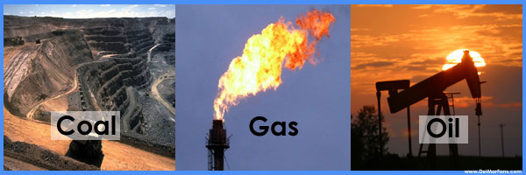
Raw material
Plastics are made through a polymerisation or polycondensation process.
Plastics are derived from natural, organic materials such as cellulose, coal, natural gas, salt and, of course, crude oil.
Naturally occurring polymers include tar, shellac, tortoiseshell, animal horn, cellulose, amber, and latex from tree sap.

Slide 4
How are plastics made?
It starts with raw materials, such as natural gas, oil or plants, refined into ethane and propane.
1
2
Ethane and propane are treated with high heat, in a process known as cracking. This is how they’re converted into monomers such as ethylene and propylene.
3
The monomers ethylene and propylene are combined with a catalyst to create a polymer “fluff,” which looks like powdered laundry detergent.

Slide 5
How are plastics made?
4
The polymer is fed into an extruder, where it is melted and fed into a pipe.
5
The plastic forms a long tube as it cools.
6
The tube is cut into small pellets.
7
Pellets are shipped to factories to be melted and molded into water bottles, food packaging, auto parts, medical devices and much more.

Slide 6
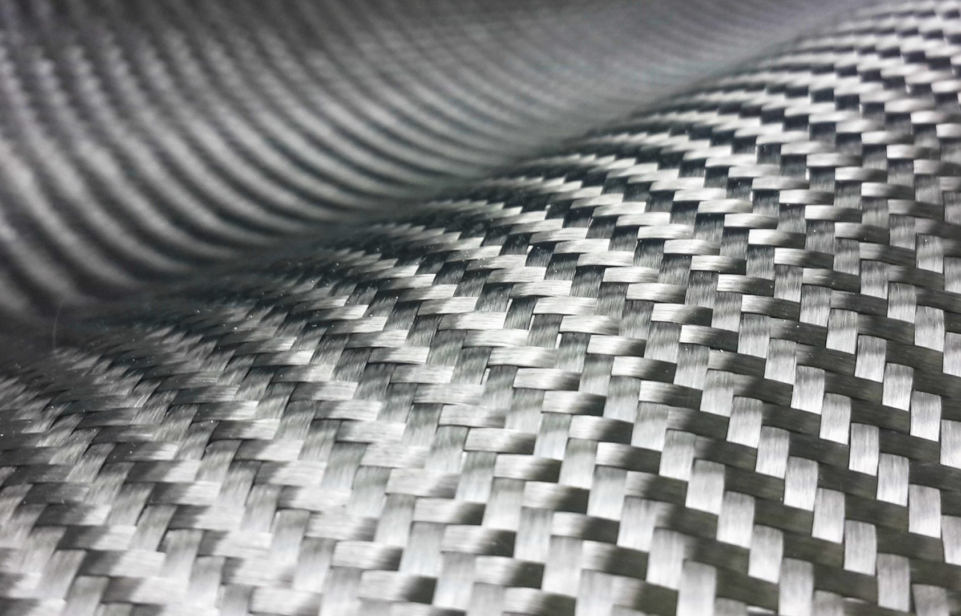
additives
The basic chemicals used in the manufacture of plastics are extracted from coal and crude oils.
Additives can be added to modify the properties of the plastic e.g. carbon fibres can be added to improve the strength.

Slide 7
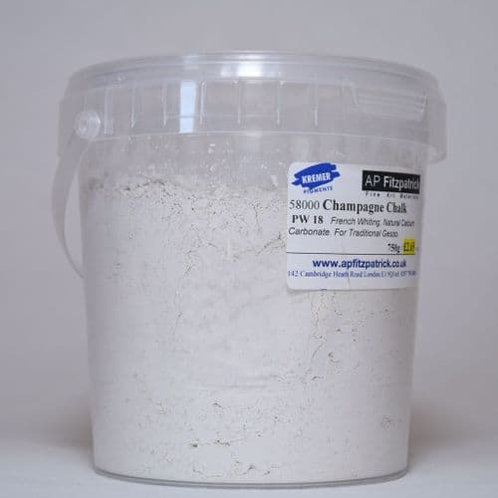
FILLERS
Fillers can be used to bulk out the plastic changing its appearance and reducing its cost. For example, chalk.

Slide 8
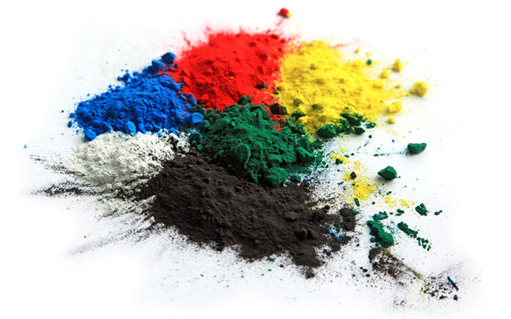
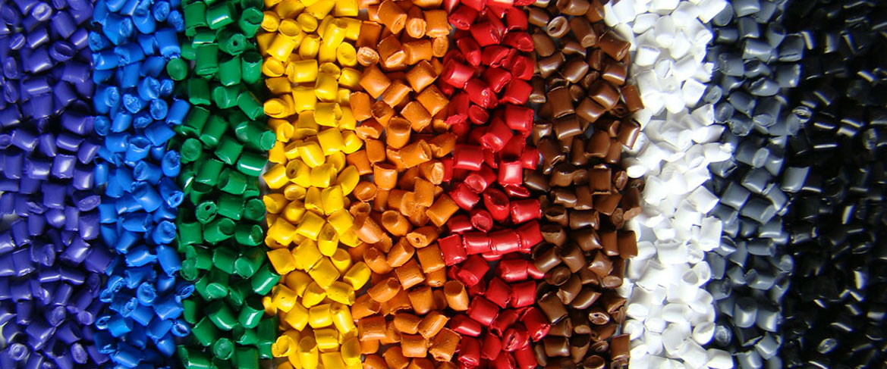
pigments
Pigments can be added to give the plastic colour.

Slide 9
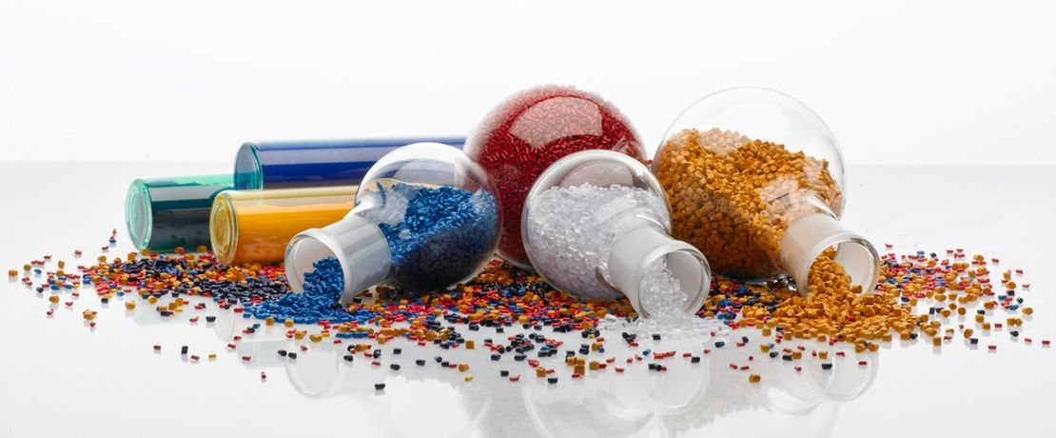
stabilisers
Stabilisers are 'intentional additives' used to prevent environmental effects (of heat, UV light, etc.) on the polymer. They are added to plastics to afford protection against heat (thermal), UV and mechanical degradation of the polymer during both processing and use.

Slide 10
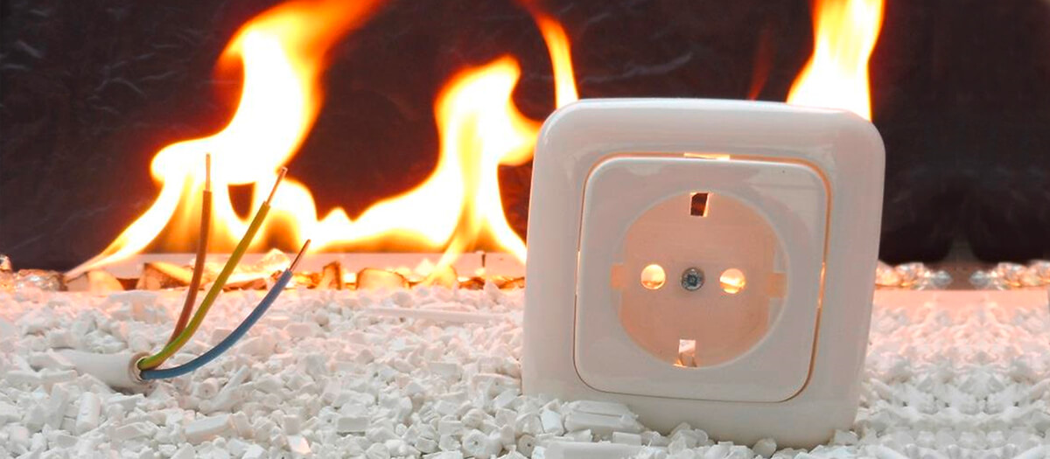
FLAME RETARDENTS
Flame Retardants can reduce the flammability.
Example: You can make fire-resistant plastic by adding hydrated magnesium oxide or aluminium oxide alone or with phosphorus or bromine compounds to low-density polyethylene.
When there's a fire outbreak, the compounds decompose and absorb the fire energy, preventing the plastic from burning.

Slide 11
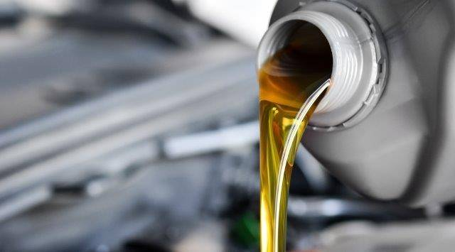
lubricants
Lubricants help the flow of plastic during processing.
Lubricants based on silicone, perfluorinated PFAE, mineral oils, and synthetic hydrocarbons (SHC or PAO), typically work well with plastics.

Slide 12
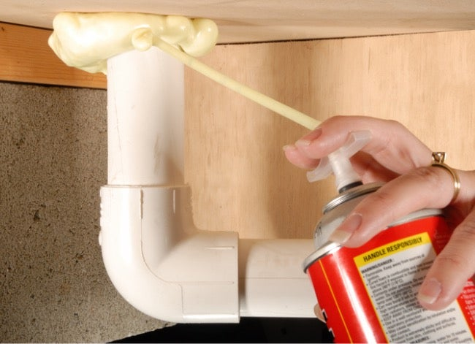
blowing agents
Blowing agents release gas to make foamed or expanded plastics, reducing material and cost. For example, expanding foam.

Slide 13
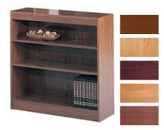
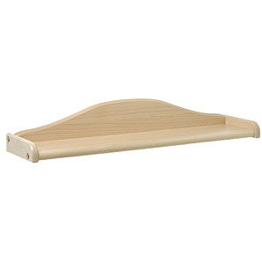
Plastics were initially used as a substitute for more expensive materials e.g. a semi synthetic material called Parkesine was used to replace ivory for billiard balls etc.
The idea of plastic being an imitation of other materials has taken a long time to eradicate.
Plastics now possess vital properties suited to new technology. There is now an acceptance of the match between plastic and high quality products and technology.
Plastics are also being used to replace wood and metal as a most cost affective alternative e.g. plastic wood effect veneers on shelves, cabinets, tables etc.
Plastics

Slide 14
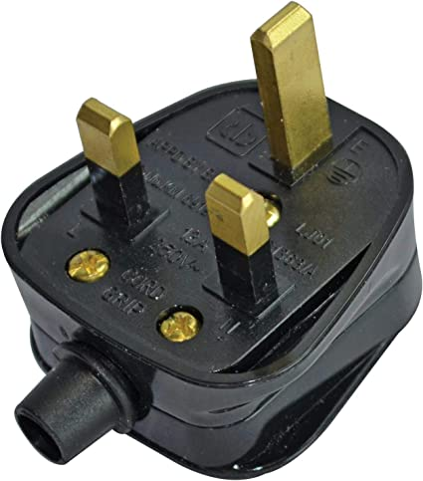
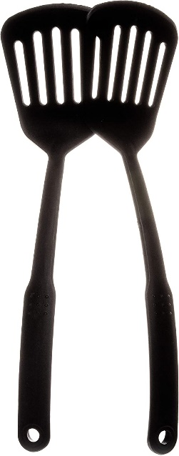
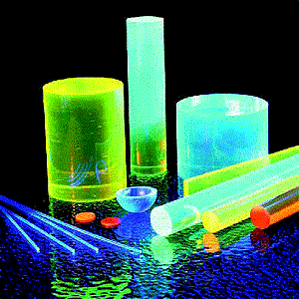
Properties
Properties:
Light weight
Resistance to corrosion
Low thermal conductivity
Can be translucent, transparent and opaque
Electrically resistant
Easily formed
Recyclable

Slide 15
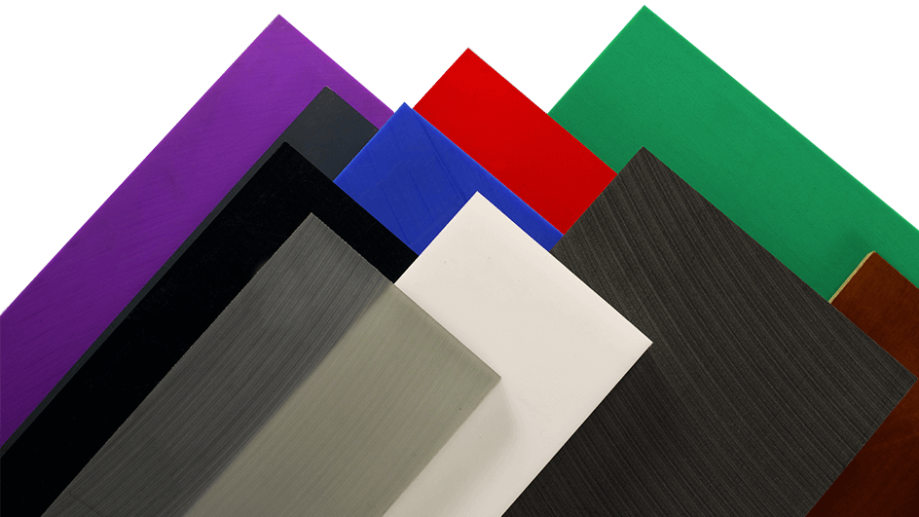
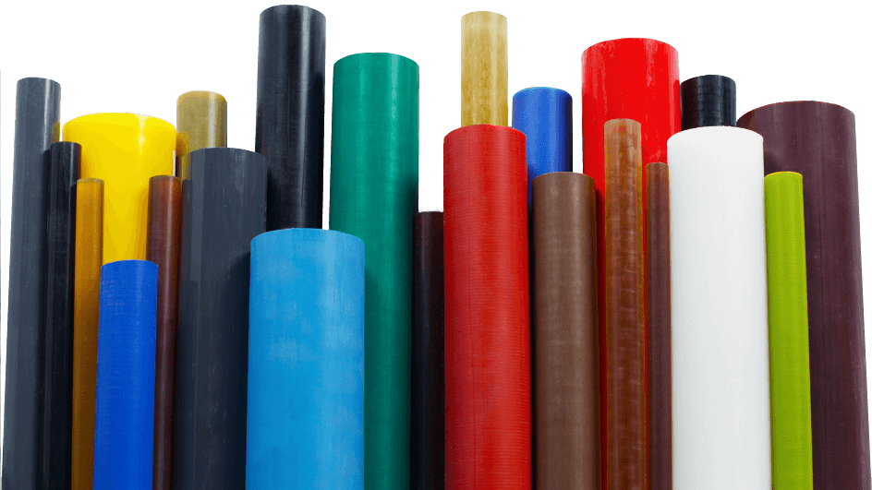
forms
Sheets, rods, tubes and bars

Slide 16
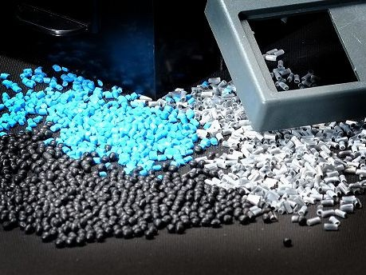
forms
Moulding compounds

Slide 17
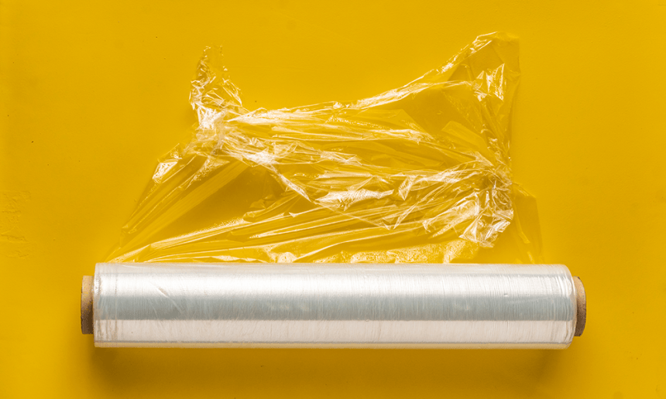
forms
Thin layers of films

Slide 18
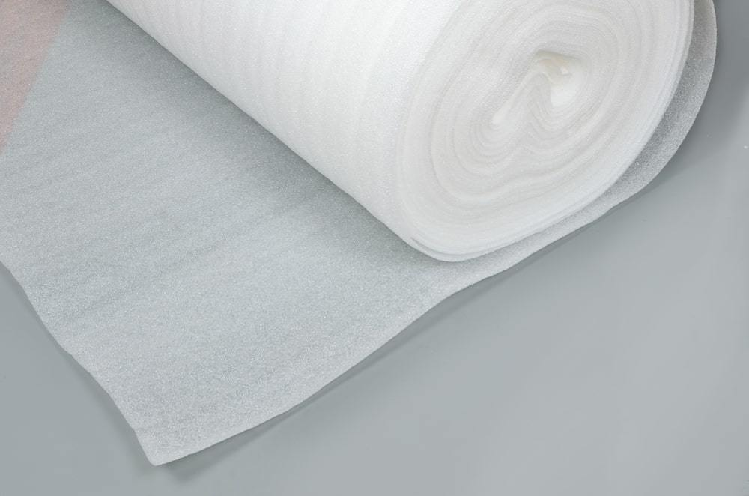
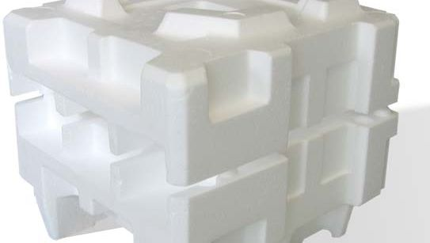
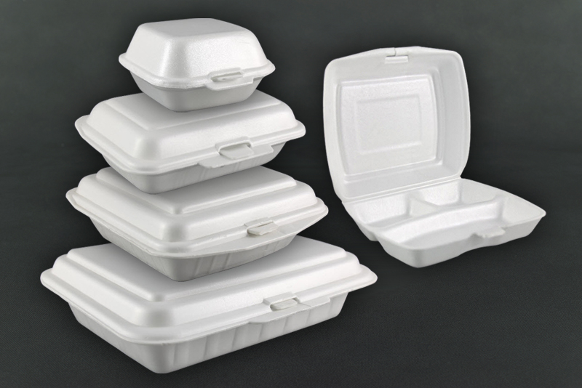
forms
Foams

Slide 19
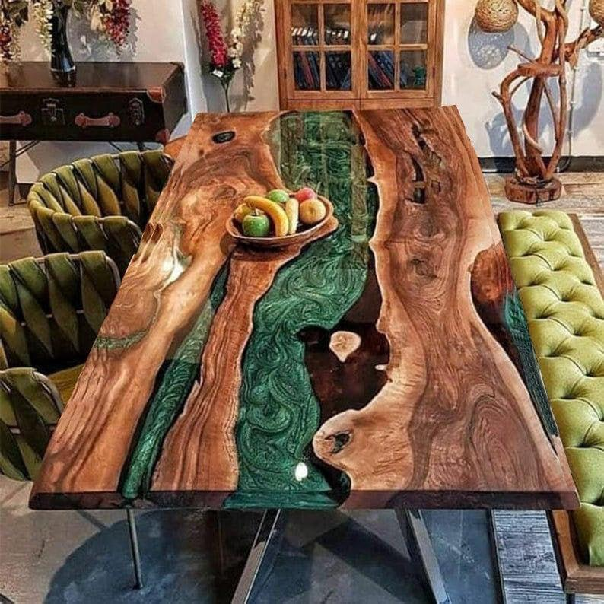
forms
Casting compounds e.g. resin
https://www.youtube.com/shorts/f9DyrteyFl0

Slide 20
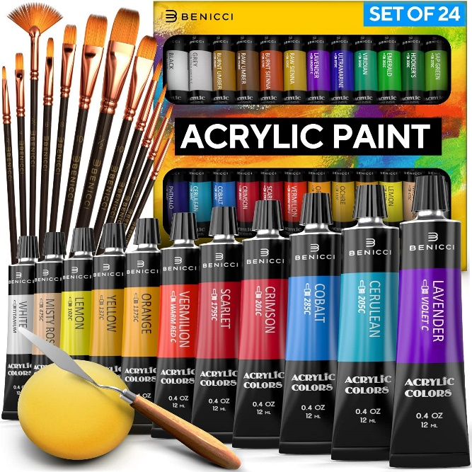
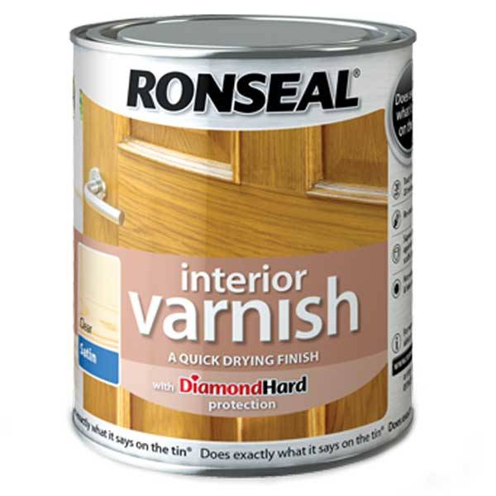
forms
Paint, varnish and lacquer

Slide 21
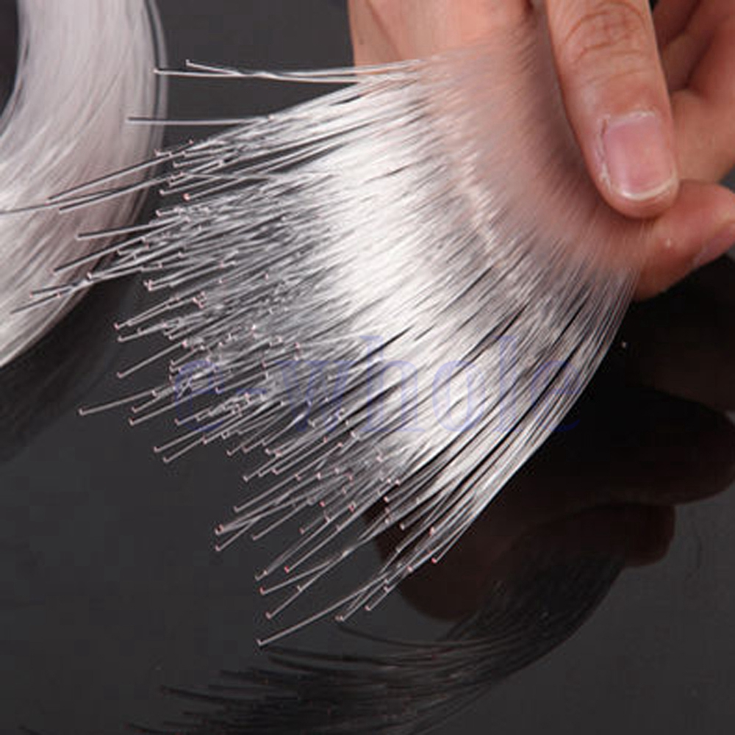
forms
Filaments and fibres

Slide 22
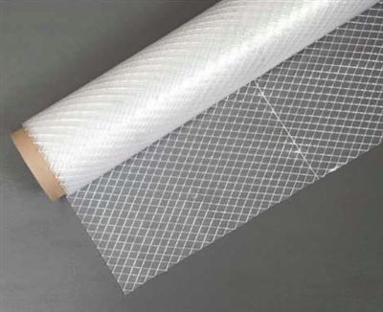
forms
Composites which contain reinforcing materials.

Slide 23
Plastic identification
Recognising and naming plastics can be difficult. As new plastics have been developed there scientific names have been simplified to more ‘trivial’ names including-
Polyethane terephthalate (PET/PETE)
High density polyethane (HDPE)
Polyvinyl chloride (PVC)
Polypropene (PP)
Polystyrene (PS) etc.
However, sometimes it may not be possible to see an identification label. If that is the case there are a number of processes you can do to identify a material. Including-
Flame tests (May include flame colour or smell)
Comparison to other materials
Aesthetic aspects
Density/float tests
Scratch tests
Drop tests
Visual examination of surface finishes
Identification symbols on plastic parts

Slide 24
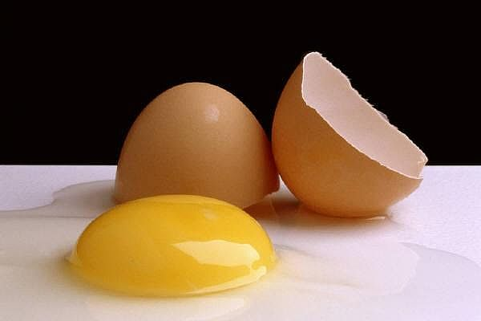
Thermosetting plastics
These plastics are formed by a chemical process which leaves them in a fixed state.
They cannot then be softened or reformed by adding heat.
Although Thermosetting plastics can withstand high temperatures, excess heat will simply cause them to decompose.
An egg yolk is a good analogy – when the yolk is raw it is soft in a liquid state but if heated it becomes hard and cannot be reformed again.
Thermosetting plastics are often needed when a product has to be resistant to extreme temperatures, electrical current, chemicals or wear. Many can also resist high impact levels when reinforced with another material e.g. Glass Reinforced Plastic (GRP).

Slide 25
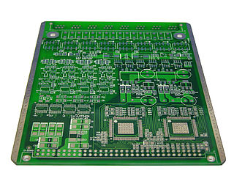
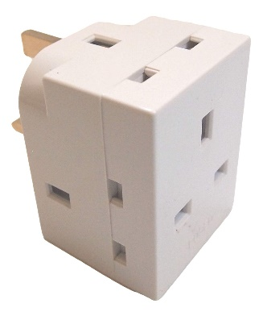
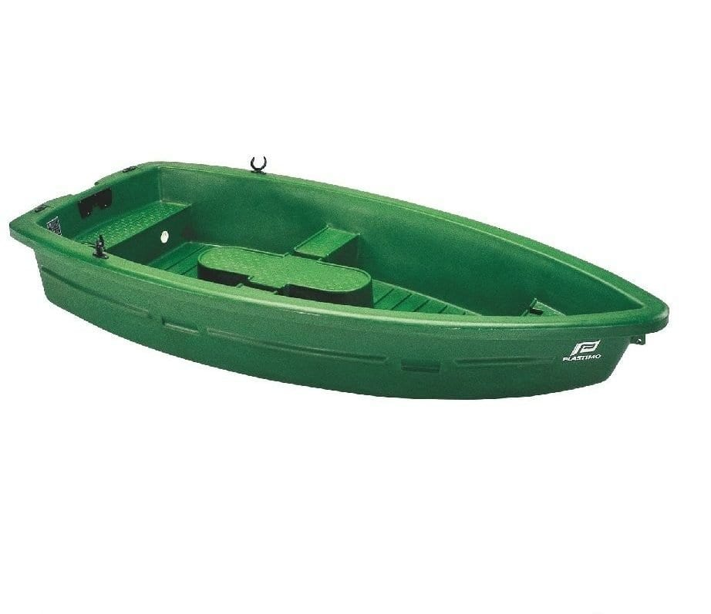
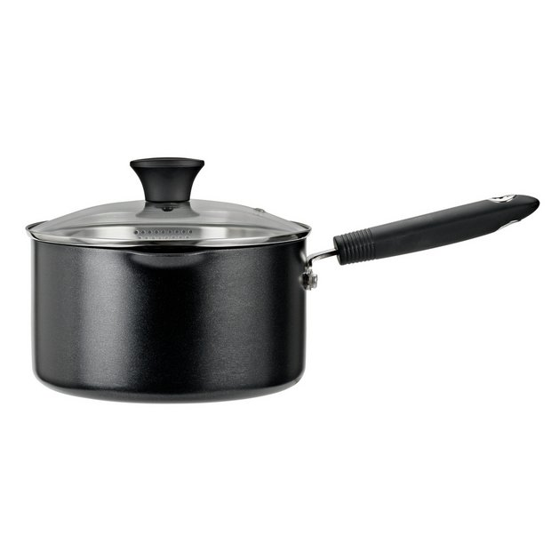
Thermosetting plastics examples
1.
2.
Epoxy Resin (e.g. printed circuit boards, adhesives, bonding).
Urea Formaldehyde (e.g. electrical fittings, handles, control knobs).
Polyester Resin (e.g. car bodies, boats).
Phenol Formaldehyde (e.g. dark coloured electric fittings, bottle tops, kettle handles, saucepan handles).
3.
4.

Slide 26
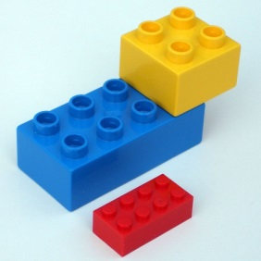
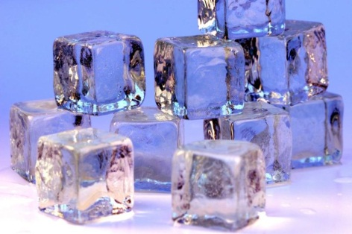
Thermoplastics
Thermoplastics soften when heated and harden again when cool. This process can be repeated indefinitely.
When Thermoplastics are soft they are easily formed under pressure. When gently reheated it will return to it original shape. This is called Plastic Memory.
Thermoplastics are used in products which do not have to withstand high temperatures.
Ice is a good analogy for this. When cold it is hard and cannot be moulded but when heat is applied it returns to a liquid state and can be poured easily, when poured into the desired shape it can then be cooled down and it will become hard again.

Slide 27
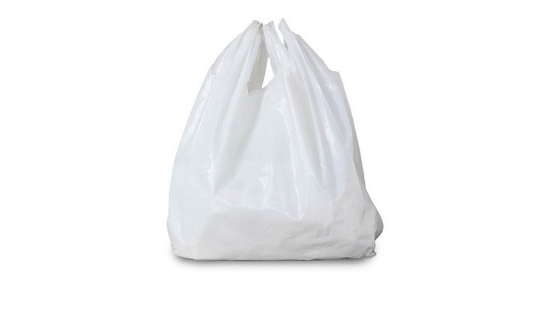
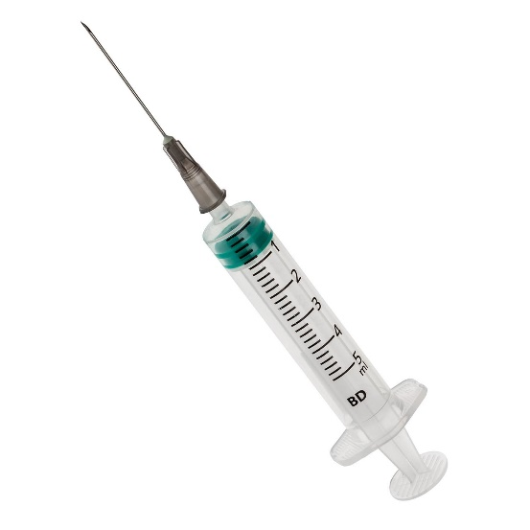
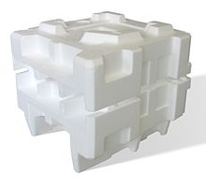
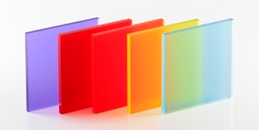
Thermoplastics examples
1.
Polythene (e.g. plastic bags)
Polypropylene (e.g. medical equipment, syringes)
Polystyrene (e.g. packaging)
Polyvinylchloride (e.g. gutters)
Acrylic (e.g. windows, car reflectors)
2.
4.
5.
3.

Slide 28
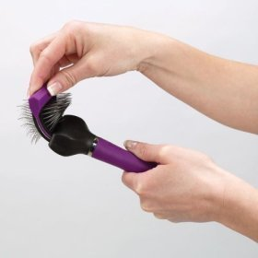
elastomers
Elastomers are a particular type of thermoplastics which have elastic properties.
They can be likened to rubber in how they react to pressure and feel to touch.
Elastomers can withstand a particularly large amount or deformation and can be stretched several times there original length.
They can be used for waterproof seals, flexible handles, sportswear and foam padding.
Examples include silicon elastomers, natural rubbers for tires etc.

Slide 29
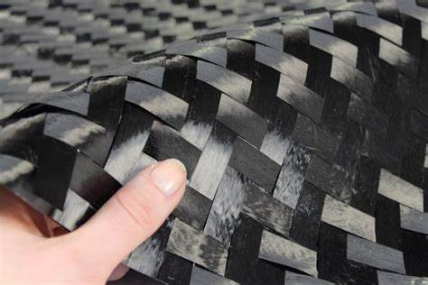
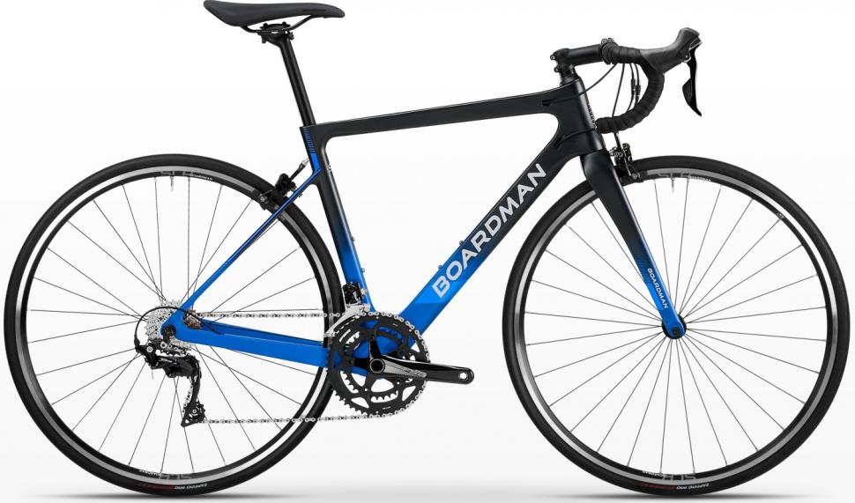
Composite materials
A Composite Material consists of two or more substances which combine to produce a material with properties which cannot be achieved by any individual substance.
A good example of this is the use of carbon fibres embedded in resin (Carbon Fibre Reinforced Plastic or CFRP). This material is light weight but has a high tensile strength while also having better corrosion resistance and fatigue performance than most metal alloys. It is used in car chassis and aerospace design.
One of the components forms the matrix or base material while the other component provides reinforcement.
Wood and Leather are Natural Composites containing polymer/fibre composites.
Fibre Reinforced Metals are being used more frequently because of there improved stiffness, high heat resistance and wear properties.

Slide 30
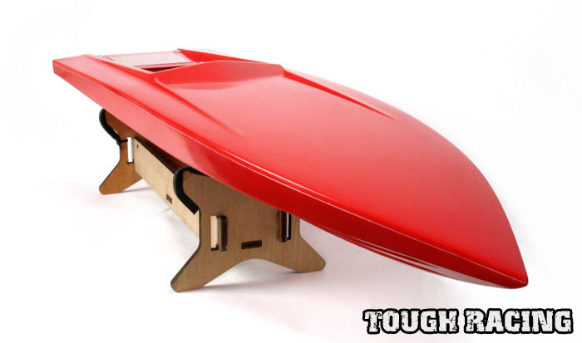
Composite materials cont.
There are 4 ways to reinforce a composite material:
Dispersion Composites – These are very fine particles (1% - 15% in volume) which harden the material decreasing internal defects. This type of composite is characterised by increased strength which is unaltered by temperature.
Particulate Composites – These contain larger particles (greater than 20% in volume). The brittle nature of ceramics has resulted in a large number of reinforced materials in the class.
Fibrous Composites – These come in a wide variety of materials. The parent material is used to bind the fibres together and protect the surface from damage. Fibre reinforced plastics (FRPs) are used in boat hulls, car bodies etc.
Laminated or Layer Composites – These have alternate layers of material bonded together. Plywood in probably the most common, Safety Glasses also have a plastic film sandwiched in between to layers of glass.

Slide 31
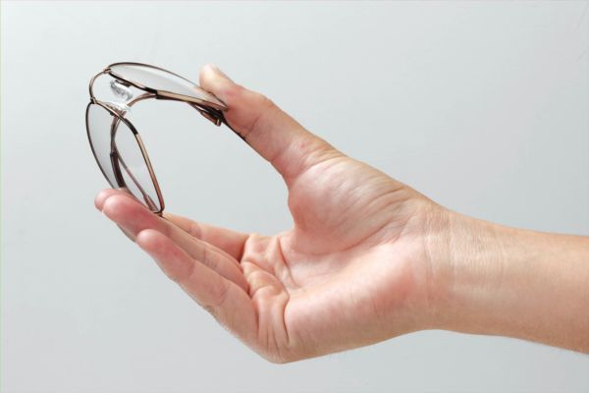
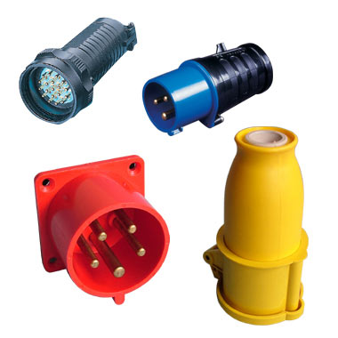
Smart materials
The properties of materials stay more or less constant.
Smart Materials, however, respond to light and temperature e.g. Reactolite Sunglasses.
Shape Memory Alloys (SMAs) retain there shape until heated. SMAs have high electrical resistance which in turn makes them suitable for electrical connectors, triggers and valves.

Slide 32
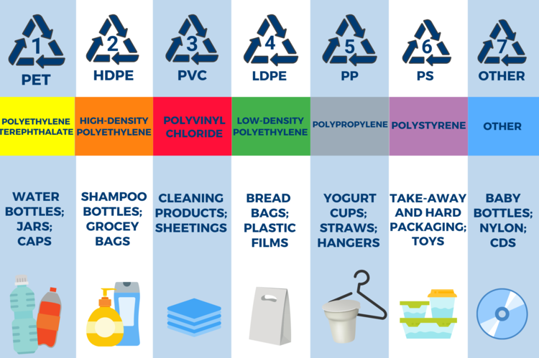
Recycling plastics
Not all plastic is born equal. In fact, not only can plastic be found in a variety of different shapes and colours, but also in many different types.
Each one is different from the other and has different uses. For example, some types of plastic are reusable and others aren’t because of the chemicals they contain; some can be recycled and others need to be disposed of in a different way.
In order to help you make better-informed decisions about the products that you buy, today we will go through the seven different types of plastic, how they differ, and their impact on the environment.

Slide 33
Most easily recycled
Easily recycled
Sometimes recycled
Sometimes recycled
Regularly recycled
Rarely recycled
Almost never recycled

Slide 35
For the exam: You may be asked about any of the following plastics
Polythene (high and low density)
Polyvinyl chloride
Polystyrene
Nylon
Cellulose acetate
Acrylic
Polypropylene
ABS
Epoxy resin
Melamine
Formaldehyde
Urea formaldehyde
Polyester resin
Glass-reinforced plastic
Carbon-fibre plastics
Elastomers
Labelling and symbols
You must remember these!
LEARN THEIR PROPERTIES

Slide 36
Plastics
Once this has taken place,
Additives can be added to modify the plastic and strength.
Fillers can be used to change its appearance and cost.
Plastic was originally used as a cheap substitute for other materials, e.g. ivory in billiard balls. “An imitation of the real thing”
Pigments can be added to add colour,
Stabilisers can be used to guard against damage.
help the flow of plastics during processing.
Flame Retardants reduce flammability.
The basic chemicals used when making plastics are Coal and Crude Oil. These are obtained by using heat and chemical catalyst.
Lubricants Blowing Agents release gas to expand the plastic.
Plastic are now strongly associated with products of today, some of the vital processes and characteristics of plastic make it increasingly more popular in today's market.
Information
Moulding Compounds
A wide range of Plastics are now available that can be moulded, extruded, cast or used as coatings. Plastics are replacing traditional materials such as wood and metal.
Casting Compounds
Sheets Rods Tubes and Bars
Thin layers of films
Plastics
Forms
Light Weight
Foam
Properties
Colourful
Paint, Varnish etc.
Can be Cheaper
Composites for Reinforcing.
Recyclable
Resistant to Corrosion
Filaments and Fibres
Low Thermal Conductivity
Can be Translucent, Transparent or Opaque.
Electrically Resistant

Slide 37
Plastics
Categories
Analogy: Egg Yolk – Raw it is in soft liquid state, when heated becomes hard and cannot be altered.
Although they can withstand high temperatures excess heat will eventually cause the plastic to decompose.
Usually used when resistance to extreme heat, electrical currents or chemicals is needed.
Once Set they cannot be softened
or reformed even when heated. Once set this is the final shape.
Examples:
Epoxy Resin
Polyester Resin
GRP (Glass reinforced Plastic)
Formed by chemical reactions that leave them in a relatively fixed state.
Thermosetting
Uses:
Electrical Fittings
Camera Cases
Handles
Car bodies etc.
Plastics
Thermoplastics soften when heated, can be changed shape and harden when cooled. This process can be repeated many times.
Elastomers – A branch of Thermoplastics that contain elastic properties, likened to Rubber. They can be stretched to several times their length
Uses:
Waterproof Seals
Flexible Handles
Sportswear
Thermo
These plastics have Plastic Memory. When soft they are easily formed under pressure but when reheated they will return to there original shape.
Uses:
Signs
Lighting
Packaging
Containers etc.
Analogy: Ice – when cold it is hard and cannot be moulded when heat is added it turns to a liquid and can be poured easily.
Examples:
Acrylic (PMMA)
Nylon (Polyamide)
Polystyrene

Slide 38
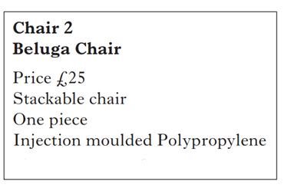
Past paper question
Justify the use of the materials used in the production of the chair. (4 marks)

Slide 39
Past paper question
Statements which identify issues such as:
• durability of material
• strength issues
• safety
• suitability for production methods
• aesthetic properties
• weather proof
• ease of clean/ hygiene (Beluga chair)
• re-cycling
• form of material eg tube – lightweight
• any other suitable statement
Statements could include:
‘The unit cost of chair two is very cheap because the materials used are
easily mass produced by injection moulding.’ (Worth 1 mark)
‘The style of the chair would be aimed at a market that likes stylish,
colourful designs. Colours can easily be changed to suit market trends
and fashions.’ (Worth 2 marks)
‘In chair one steel tubing was used because it is cheap, strong and
lightweight.’ (Worth 1 mark)

Slide 40
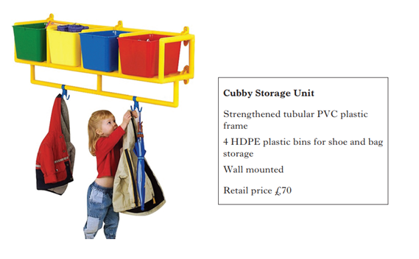
Past paper question
Justify the use of the materials used in the production of the coat racks. (4 marks)
You should use the data book and Powerpoint on Microsoft Teams to help with your answer.

Slide 41
Past paper question
Statements which identify issues such as:
• durability of material. (non corrosion)
• readily available materials. (eg standard forms of supply)
• strength to weight issues.
• safety
• suitability for production methods
• function of component parts
• aesthetic properties
• ease of clean/hygiene
• re-cycling.
• any other suitable statement.
Six valid statements @ 1 mark each. (5+1)
NB Mention of mass production can be awarded in 1b only.
No repetition of identified issues.
No marks for scratch resistance (in stem).

